Slide 1

Language of body
Group 7
Andrès Bertazzi
Riccardo Kubler
Nicolò Pisanu
Marco VIviani

Slide 2



Outline
Introduction
Settings
Python
Max
Processing
Demo
Future works

Slide 3
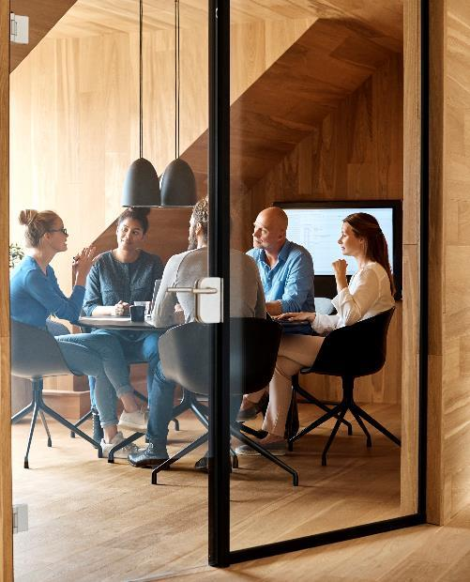


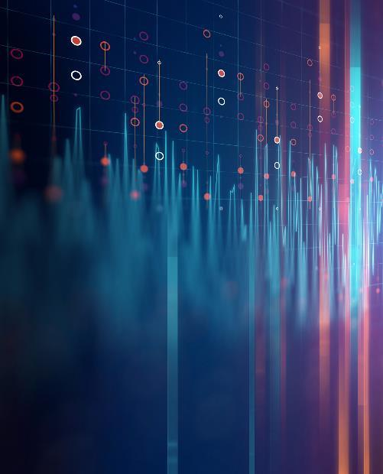
Introduction
The aim of the project is to develop a virtual musical instrument for an artistic installation
The idea is that anyone moving his entire body can be involved by generating music
The visual representation reacts to the inputs given by the camera and shows the notes on a screen

Slide 4

Settings
The settings consist of a camera, a system of loudspeakers and a screen.
The system analyzes the movements and the gestures of the user in order to generate music mapping some features (pitch, tremolo effect,...) and involving the player and the audience with a visual representation on a screen.
The user stands in front of the camera and moves his entire body in order to control the virtual instrument.
With the hands it controls the melody generation (pitch, volume and filters) while the entire body it manages higher level music parameters like harmony and rhythm and other audio FX.

Slide 5
Hackaton Prototype
FUNCTIONING:
2 hands: right hand controls volume and pitch, left hand a tremolo effect
TOOLS:
Mapping the position in the 2D space and recognition of hands’ gestures → Python
Visualization: a simple piano roll that shows the played notes reacting to the input → Processing
Sounds: real time generation → Max8

Slide 6
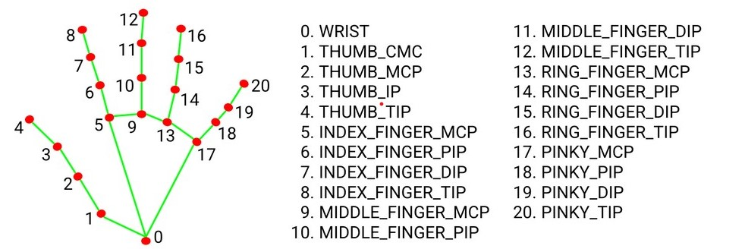
Python
IMPORTANT LIBRARIES:
Opencv: provides a real-time optimized Computer Vision library in order to manage inputs from the camera
PythonOsc: sends OSC messages to Max8
Mediapipe: it employs machine learning (ML) to detect 3D landmarks of the hands from just a single frame (average precision of 95.7% in palm detection)

Slide 7
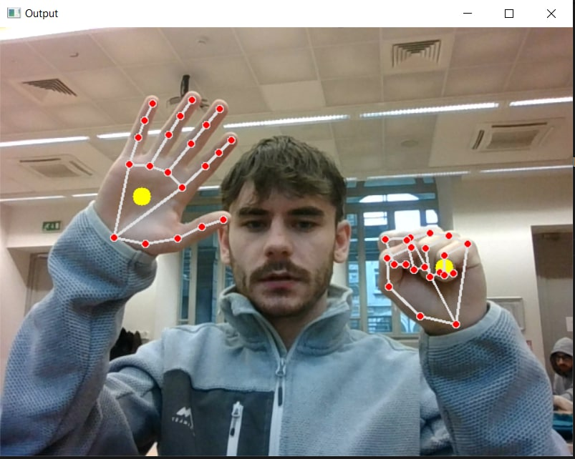
Python
Left hand rotation = tremolo
Vertical movement of the right hand = pitch
Horizontal movement=amplitude
Open/Close right hand: sound on/off

Slide 8
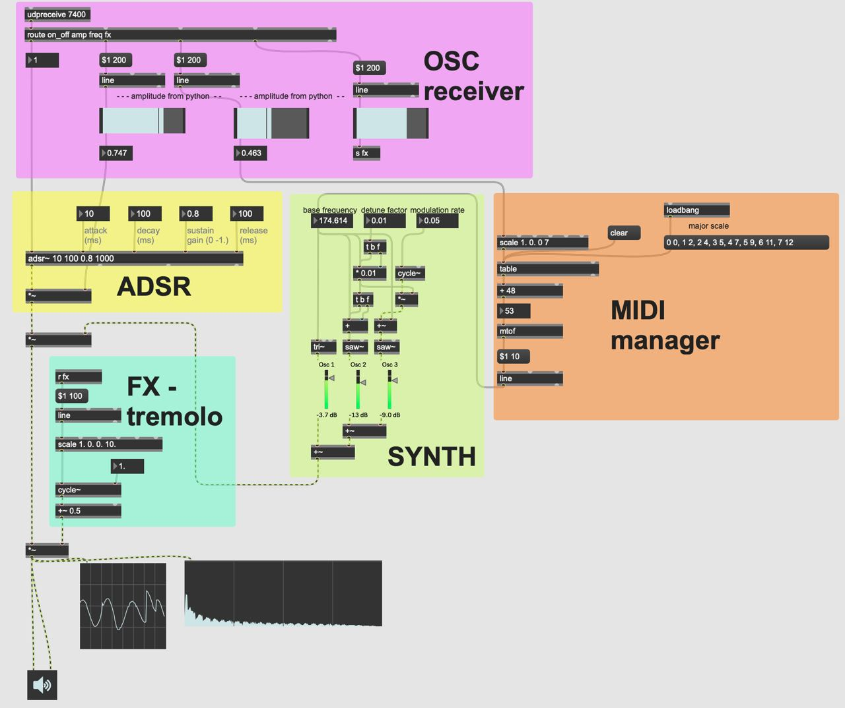
Max

Slide 9
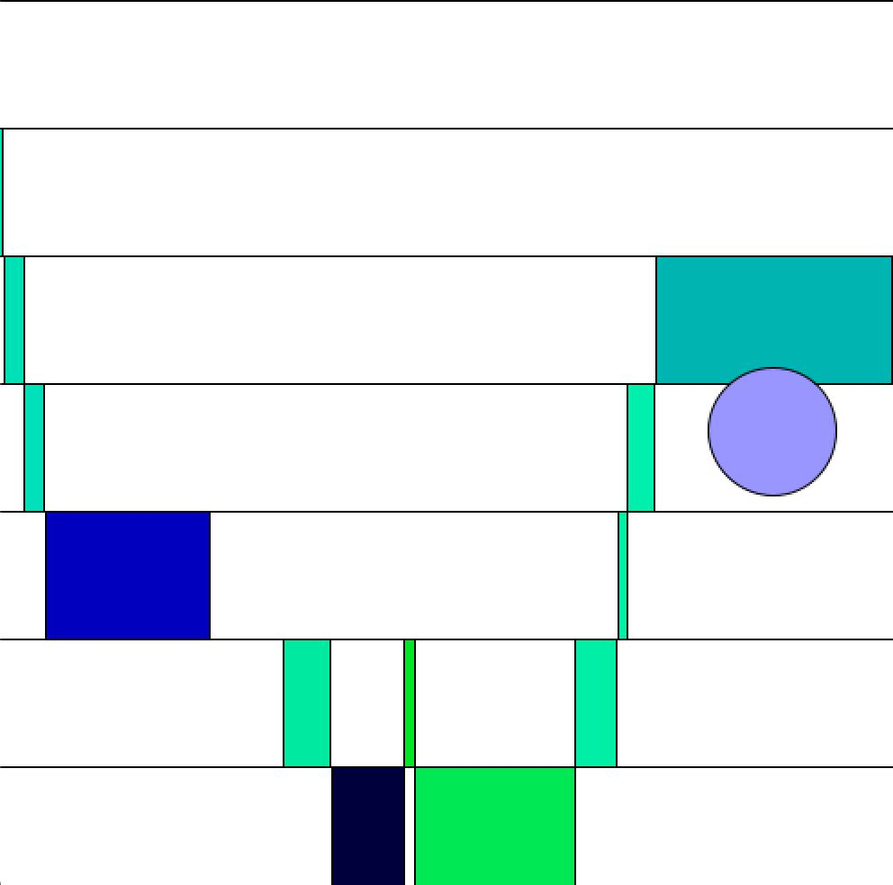
Processing

Slide 10

Future works
More control on the synthetizer and on the filter we can use
Chords or ambiental sounds generation through melodic analysis
Appealing graphic visualization for performances
Entire body detection
Control of more parameters

Slide 11


Thanks for the attention!

